Slide 1



Machine Predictive Maintenance Classification
Team Members
Manasvi Patel 20162121008
Manya Tripathi 20162121009
Meet Prajapati 20162121010
Stuti Radhanpura 20162121024
Group - 2

Slide 2





Machine Failure Classification
Consider a manufacturing plant that is looking to reduce downtime and maintenance costs for its production equipment.
Using the given factors like air temperature, rotational speed, tool wear etc we can predict the machine failure which can be useful for the organization.
It will reduce the loss of the company by predicting the failure earlier so the company can do the service of the machine
By building model based on given dataset we can reduce the cost.

Slide 3


Data Description
Attributes : 10
1. UID
2. productID
3. air temperature [K]
4. process temperature [K]
5. rotational speed [rpm]
6. torque [Nm]
7. tool wear [min]
8. failure type
9. type of failure
10. target [Failure Or Not]
File Format : csv , Commas delimited
Records : 10,000

Slide 4
Data Exploration
It is not necessary that all the given attributes are useful so we have to choose the attributes which are helpful for our model
Attributes which effect our data can be:
Type
Air Temperature
Rotational Speed
Tool wear

Slide 5
Data Quality
None of the attributes have missing or blanks values or null values.
None of the attributes have spelling inconsistencies]
There are 415 outlier in Rotational Speed .
There are 69 outlier in torque. These are valid Outlier as it was natural phenomenon.
There was plausibility for failure Type and Target.
[Failure = “No Failure” and Target = “1”]
We can exclude the Attributes from UID or Product ID as they are not impacting on hypothesis. Also exclude plausibility.
Data stored in file is delimited by commas

Slide 6

Data Preparation
Removing Failure type = “Random Failure”. RNF occurs in only 18 observations and it has a random nature therefore not predictable so we decide to remove these rows.
9 observations Machine failure is set to 1 when all types of failures are set to 0. We cannot understand if there really was a failure or not so let’s remove these observations too.

Slide 7
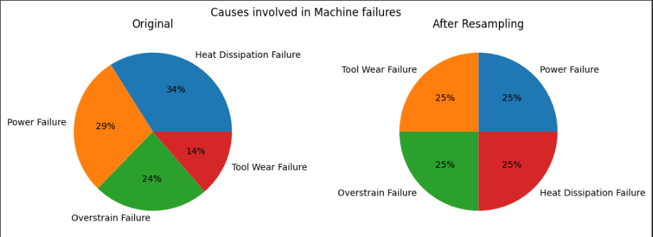
Data Preparation
Reclassify Machine Type and Failure Type attributes for further analysis.
Over-sampling with SMOTE(Synthetic Minority Oversampling Technique) for Failure Type Attributes.

Slide 8
Modeling
Predicting Is failure or not
Select a ‘Target’ as Target attributes and as input attributes we are using Type_reclassify, torque, Rotation Speed, Tool wear, process temperature, air temperature.
Partition into training and testing into 80:20 ratio respectively.
Build a Classification model on training dataset. Model : C5.0, Logistic Regression, C&R Tree, Random Tree, Tree AS
Accuracy : 97.56 [C&R Tree]

Slide 9
Modeling
Predicting Failure Type
Select a ‘Failure type’ as Target attributes and as input attributes we are using Type_reclassify, torque, Rotation Speed, Tool wear, process temperature, air temperature.
Select only failure data.
Partition into training and testing into 70:30 ratio respectively.
Build a Classification model on training dataset. Model : Random Forest, Neural Net, C5.0, Baysian Network
Accuracy : 96.76 [Random Forest]

Slide 10
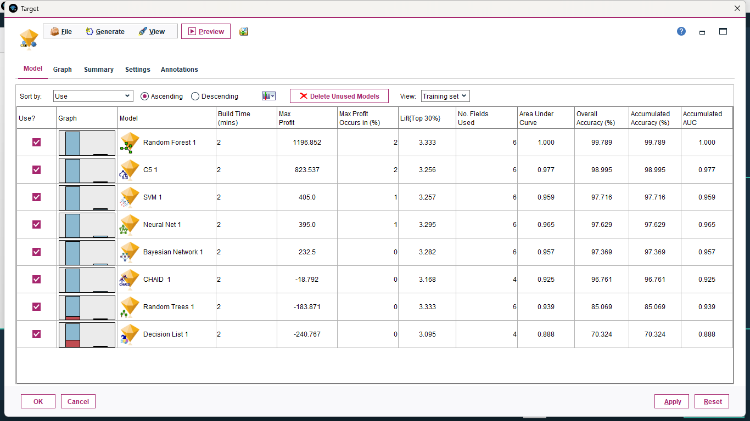
Result/Model Evaluation

Slide 11
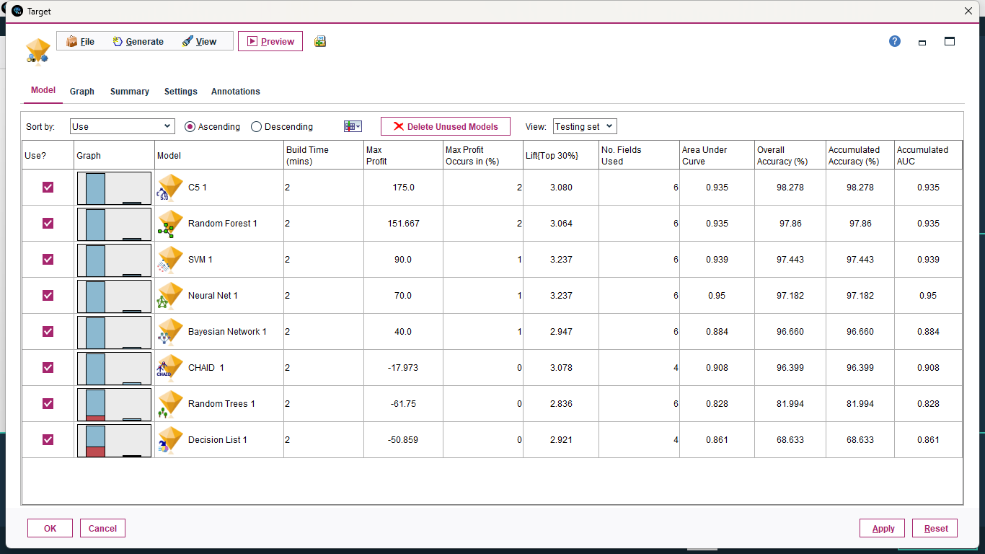

Slide 12
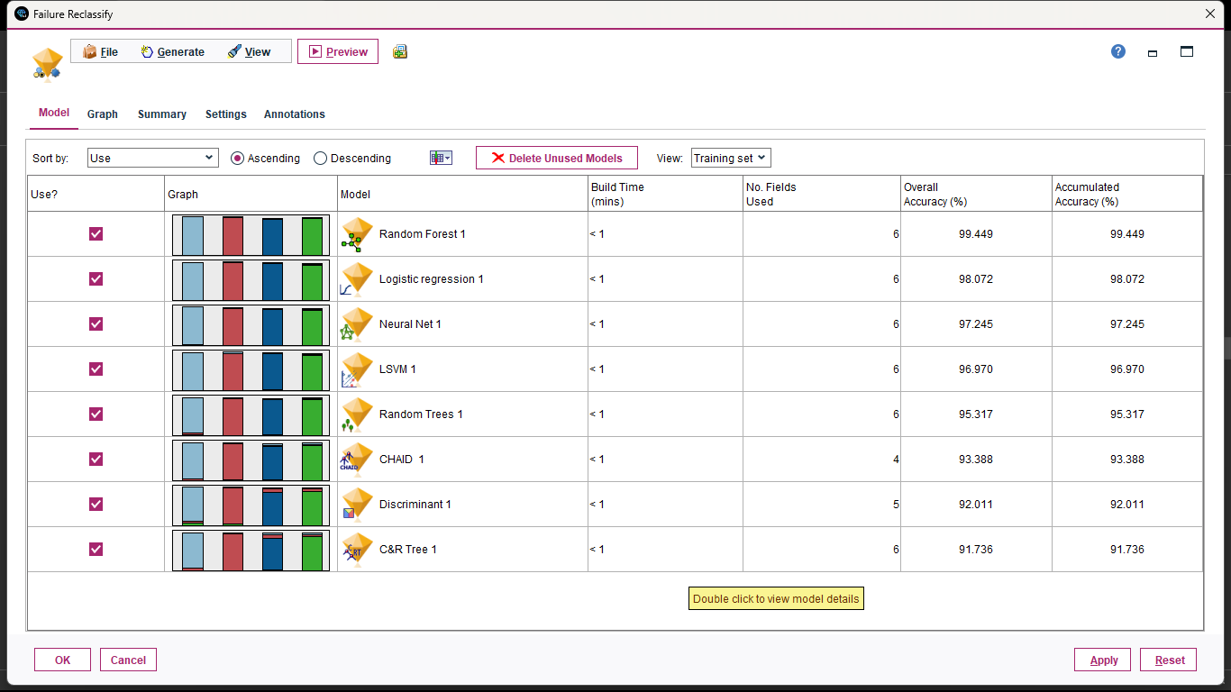

Slide 13
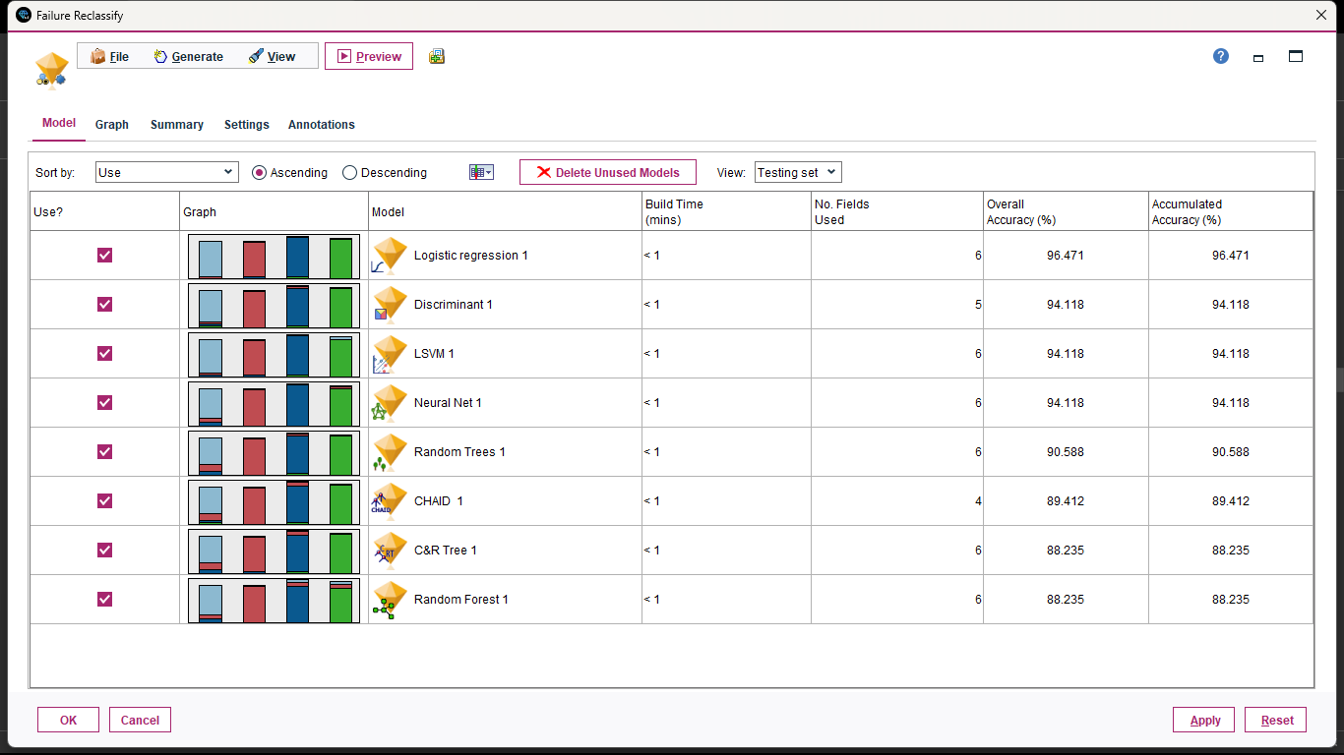

Slide 14
THANK YOU

